Slide 1

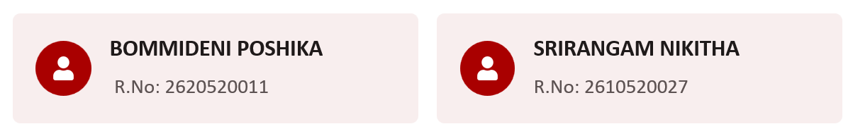



Dept. of CSA – BCA
I Year – I Semester
TO DO LIST APPLICATION
Team Name: THREE BRAIN CELLS
M NANDISHWAR REDDY
2610520015
AMGOTH ANKITH NAYAK 2610520023
CHAMAKURA DEEKSHITHA
2610520030

Slide 2
Dept. of CSA – BCA
I Year – I Semester
Introduction
Linux provides a powerful command-line environment in which users can automate everyday tasks using shell scripts. Bash is one of the most widely used shells in Linux.
A small menu-driven application is a useful way for beginners to learn how commands and programming logic work together. This project uses Bash to create a simple To-Do List Application.
The user can add task descriptions, view the list, mark a selected task as complete, or delete it. The application saves tasks in a text file in the project directory.

Slide 3
Dept. of CSA – BCA
I Year – I Semester
Problem Statement
Keeping track of daily tasks with paper notes or memory can make it difficult to record and review tasks in one place.
A simple task-list program can collect a small set of tasks and display them in an organized, numbered list.

Slide 4
Dept. of CSA – BCA
I Year – I Semester
Objectives & Scope of the project
Objectives
Scope of the project
Collect three task descriptions from the user.
Store each task in tasks.txt.
Display the saved tasks in a numbered format.
Demonstrate basic Bash input, output, file handling, and command-line usage.
The project covers a basic, single-user task list in a local text file.
It supports entering and displaying three tasks per run.
It does not include task editing, deletion, due dates, priorities, search, reminders, multiple users, or a graphical interface.

Slide 5
Dept. of CSA – BCA
I Year – I Semester
Existing vs. Proposed System
Existing System
Proposed System
Tasks may be recorded manually in a notebook or remembered without a dedicated system.
These methods are easy to start with, but tasks can be misplaced, forgotten, or difficult to review together.
The proposed system is a Bash script that asks the user to enter three tasks, saves them in a text file named tasks.txt, and displays the saved tasks with line numbers.
The file provides a basic record that can be viewed again later.

Slide 6
Dept. of CSA – BCA
I Year – I Semester
System Requirements
Hardware Requirements
Software Requirements
Computer or laptop
Minimum 4 GB RAM recommended
Keyboard and display
Ubuntu Linux or Windows Subsystem for Linux (WSL)
Bash shell
Terminal application and text editor (nano or vim)

Slide 7
Dept. of CSA – BCA
I Year – I Semester
System Design & Process Flow
Design Steps
Process Flow
Start
↓
Display “TASK LIST”
↓
Create or open tasks.txt
↓
Prompt for task 1 → Read input→ Append to file
↓
Prompt for task 2 → Read input → Append to file
↓
Prompt for task 3 → Read input → Append to file
↓
Display “Your tasks:”
↓
Print numbered contents of tasks.txt
↓
End
Main components:
User interface: Terminal prompts and messages.
Input handling: Bash read commands.
File handling: touch creates the file; >> appends tasks.
Output: cat -n displays the task list with line numbers.

Slide 8
Dept. of CSA – BCA
I Year – I Semester
Algorithm
Start the program.
Display the title “TASK LIST”.
Create tasks.txt if it does not already exist.
Prompt the user to enter the first task.
Read the input and append it to tasks.txt.
Repeat the prompt, input, and append steps for the second and third tasks.
Display the “Your tasks:” heading.
Show the contents of tasks.txt with line numbers.  End the program.

Slide 9
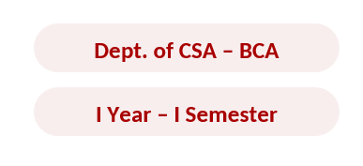

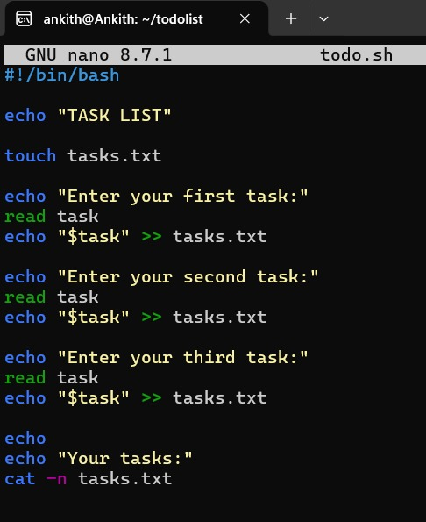
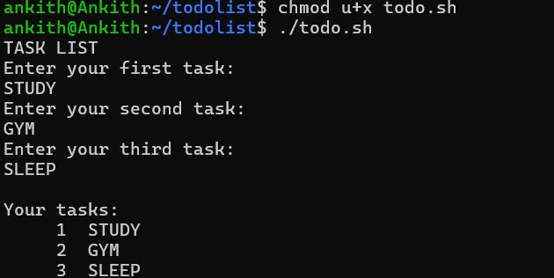

Execution
Input
Process
Output

Slide 10

12. Team Members and Responsibilities
TEAM MEMBER | RESPONSIBILITIES | DELIVERABLES
M NANDISHWAR REDDY | Problem analysis, Bash logic, path validation, file operations | Source code and algorithm
AMGOTH ANKITH NAYAK | Testing, sample outputs, documentation, presentation | Project report

Slide 11
13. Advantages
Simple and easy for beginners.
Runs directly in the Linux terminal.
Keeps tasks available after the program closes.
Demonstrates practical Bash programming and text-file handling.
Uses a clear menu for common task operations.
Can be extended with dates, priorities, or categories.

Slide 12
14. Limitations
Stores tasks for one user in one local text file.
Task numbers change when a task is deleted.
The current version does not store due dates or priorities.
There is no graphical user interface or search feature.

Slide 13
15. Future Enhancements
Store a due date for each task.
Add task priority levels such as Low, Medium, and High.
Add categories or tags to group tasks.
Search tasks by words in the description.
Add an option to edit an existing task.
Save task data in CSV format or a small database.
Add reminders using Linux scheduling tools.

Slide 14
16. Learning Outcomes
After completing this project, students should be able to:
Navigate directories using Linux commands.
Create and edit files from the terminal.
Change file permissions using chmod.
Write and execute a Bash script.
Use variables and read for input.

Slide 15
17. Conclusion
The To-Do List Application demonstrates how Linux and Bash shell scripting can support a common planning task. The project combines terminal commands with programming concepts such as variables, functions, loops, case statements, input validation, and text-file operations

Slide 16
18. References
● The Linux man-pages: bash, mkdir and related commands.
● GNU Bash Reference Manual.
● Ubuntu Linux documentation.
● Course notes and laboratory material provided by the faculty.

Slide 17



